Slide 1
Beyond the Feeble Mind
Historicizing Significant Intellectual Disability in the Institutional Era

Slide 2
Note from Dr. Burch:
I’ll be back in the office in the afternoon and will respond to emails as quickly as I can.
Next Tuesday (March 8) class: Will start with the small group presentation on Galloway’s Mean Little Deaf Queer. Please check the syllabus for the reading assignments for the class, too.

Slide 3
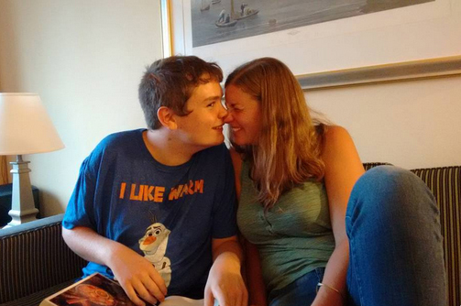
Robbie and Erin, July 2015
Notes:
Historians have adopted a flawed social constructionist approach to “feeble-mindedness” that blinds them to the lived consciousness and experience of persons with significant intellectual disabilities in 20th-century institutional settings
Persons with significant intellectual disabilities deserve a history of their own – one that addresses the specificities of their institutional treatment and affirms the value and integrity of their lives.
Challenges of creating a history that humanizes institutionalized persons with significant intellectual disabilities:
Lack of written sources (because of illiteracy, physical challenges, communication impairments)
Lack of professional concern for this population
Stigma attached to this group by professionals, families, and the general public

Slide 4
Institution buildings and grounds
Administration and staff personnel and working conditions
Medical and psychiatric records (limited)
Evidence of personal experiences and peer relationships
Notes:
Areas of inquiry that can reveal the experience of persons with significant intellectual disabilities:

Slide 5
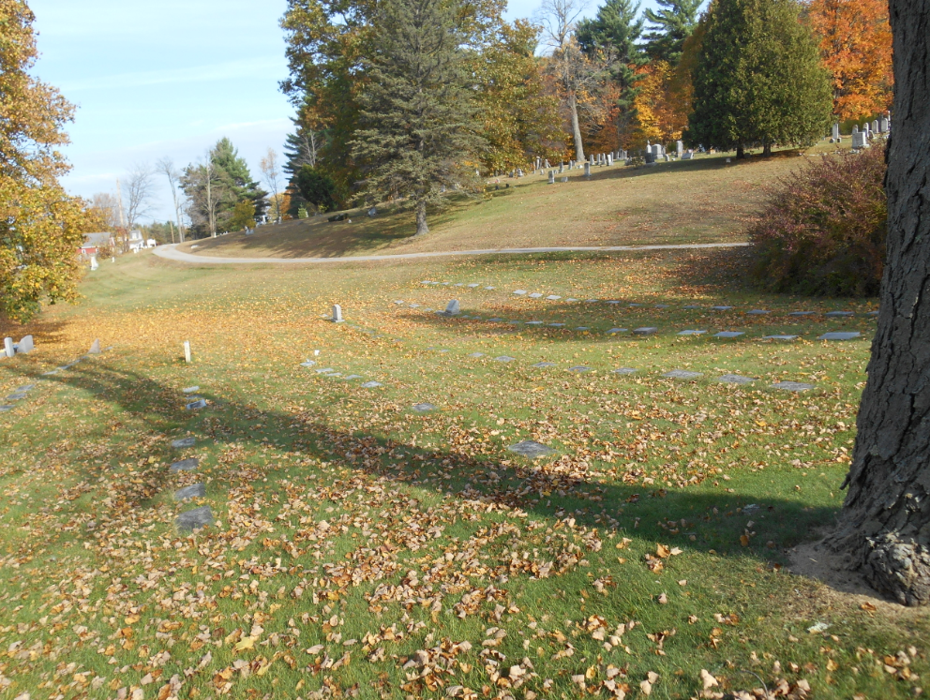

Slide 6
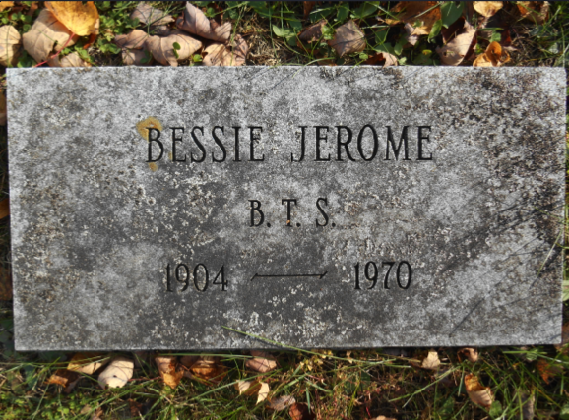

Slide 7
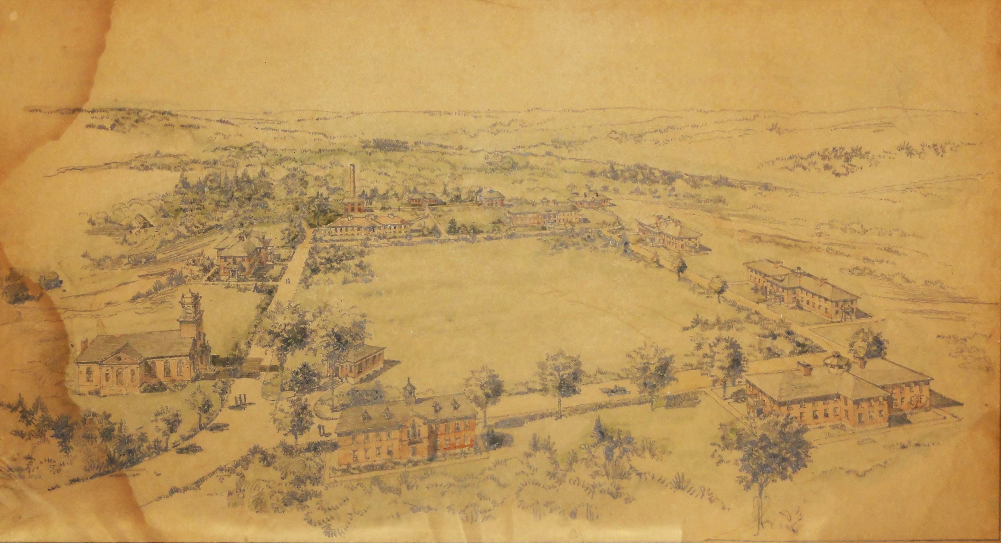
The Brandon Training School, as envisioned at the beginning, 1915-1919.
Notes:
Layout of the Brandon Training School

Slide 8
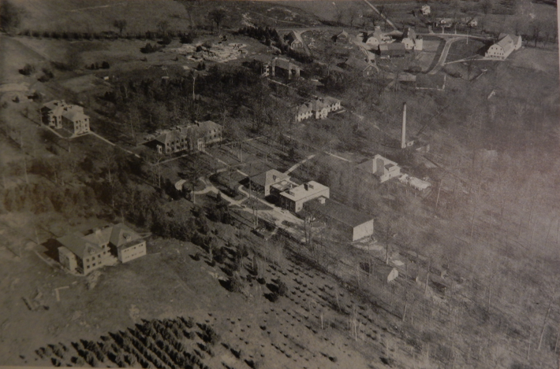
Aerial photograph of the Brandon Training School circa 1946
Notes:
1946 – comprehensive welfare survey
Proximity of Administration and Education Buildings reveals privileged treatment of “high-grade” cases
Physical plant improvements favor “high-grade” inmates (e.g., play equipment, educational facilities, etc.)
Inmates’ relationship to the world beyond the institution: “high-grade” versus “low-grade” experience (“low-grade” entirely confined)
Dormitories segregated by assessed degree of impairment
Dire living conditions in low-grade dormitories (poor sanitation leading to deadly epidemics)
Sources: maps of the grounds, references to building conditions in biennial reports, budgetary outlays for building improvements and grounds (favor administration and high-grade buildings), other evidence of “sick buildings” in biennial reports

Slide 9
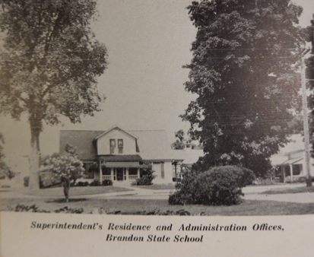

Slide 10
Aerial photograph of the Brandon Training School circa 1946
Notes:
1946 – comprehensive welfare survey
Proximity of Administration and Education Buildings reveals privileged treatment of “high-grade” cases
Physical plant improvements favor “high-grade” inmates (e.g., play equipment, educational facilities, etc.)
Inmates’ relationship to the world beyond the institution: “high-grade” versus “low-grade” experience (“low-grade” entirely confined)
Dormitories segregated by assessed degree of impairment
Dire living conditions in low-grade dormitories (poor sanitation leading to deadly epidemics)
Sources: maps of the grounds, references to building conditions in biennial reports, budgetary outlays for building improvements and grounds (favor administration and high-grade buildings), other evidence of “sick buildings” in biennial reports

Slide 11
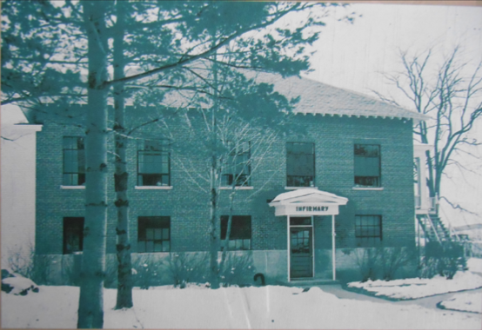
Dormitory D: One of two buildings housing “low grade” inmates

Slide 12
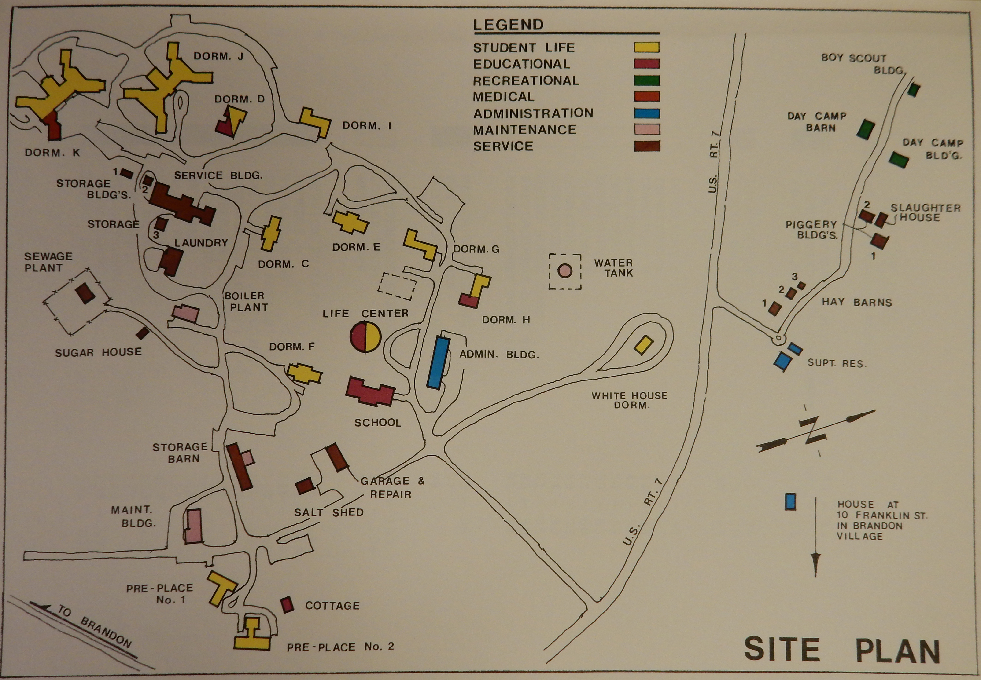
Brandon Training School Building Survey, 1980
Notes:
BTS Site Plan, 1980

Slide 13
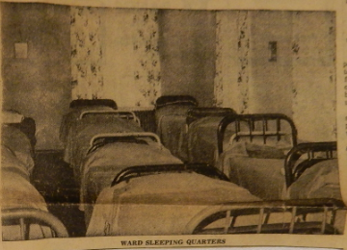
1967 – newspaper clipping from Brandon Scrapbook, VSARA
Notes:
1967 – newspaper clipping from Brandon Scrapbook, VSARA

Slide 14
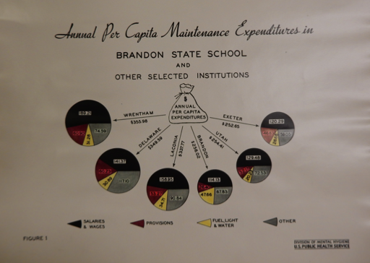
“Brandon has more than once been praised for being cheaply run.”
–Dr. Samuel Hamilton, 1943
Table included in U.S. Public Health Service Survey of the Brandon Training School by Dr. Samuel Hamilton, 1943
Notes:
Using Medical and Psychiatric Records
Limited access to records due to Vermont privacy laws
Vital statistics in Biennial Reports reveal high rates of illness and mortality among inmates with significant intellectual disabilities
Some psychiatric and medical records filter through the Vermont Eugenic Survey
These reveal medical neglect in the early period (1915-1950), followed by the use of tranquilizers to sedate “low-grade” inmates

Slide 15
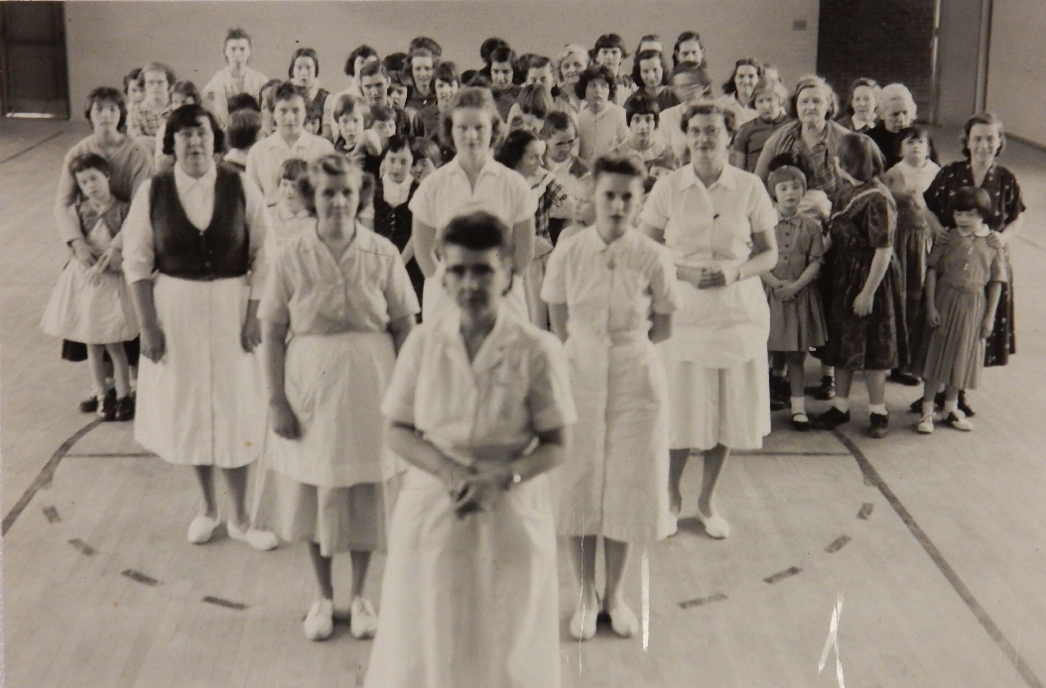
    Documenting “Dependency Relations”
Untitled photograph [n.d.], Brandon Training School Photographs and Slides, 1915-1992. Vermont State Archives. Text decription: Photograph foregrounds matron and attendants, with approximately 70 female inmates behind them. Older inmates stand with arms around younger ones. Photo is taken in a gymnasium.
Notes:
Point: Most historians have focused on the writings of institution superintendents, medical doctors, and other professionals, but…
Eva Feder Kittay notes the importance of also interrogating “dependency relations” between caregivers and the (sometimes mute) objects of their care
What were the conditions of care work at the Brandon Training School
…for care providers? (Who provided care?)
…for inmates, particularly those with significant intellectual disabilities?
Why is this important for documenting the lived experience of persons with significant intellectual disabilities? (Kittay)
Sources: Evidence of abusive and negligent care, esp. during WWII; Biennial reports, esp. in 1950s when head of the careworkers’ department authored her own report; poor pay and lack of training or support for careworkers, 1915-1950s

Slide 16
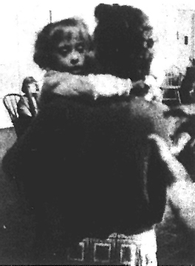
An adult inmate “of low mentality” embraces her “adopted” child.
Betty Sproston, “From What Could Be Tragic… A New, Happy Life,” Burlington Free Press, November 17, 1964
Notes:
Evidence of personal experience and peer relationships
Mutual care among low-grade inmates
Staff concerns about improper fraternization among inmates indicates varying degrees of friendship and intimacy
Some staff members affirmed humanity of “low grade” inmates
Increasing contact with outside world
This begins in the 1950s because of increased public scrutiny and parent advocacy work
Sources: Biennial reports and other state records; BTSA Newsletter

Slide 17
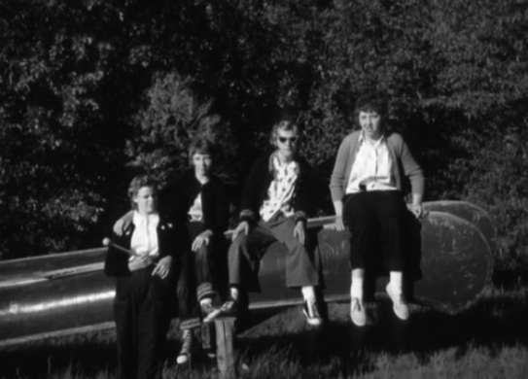
Friends Pose for a Photograph, BTS Summer Camp, n.d.

Slide 18
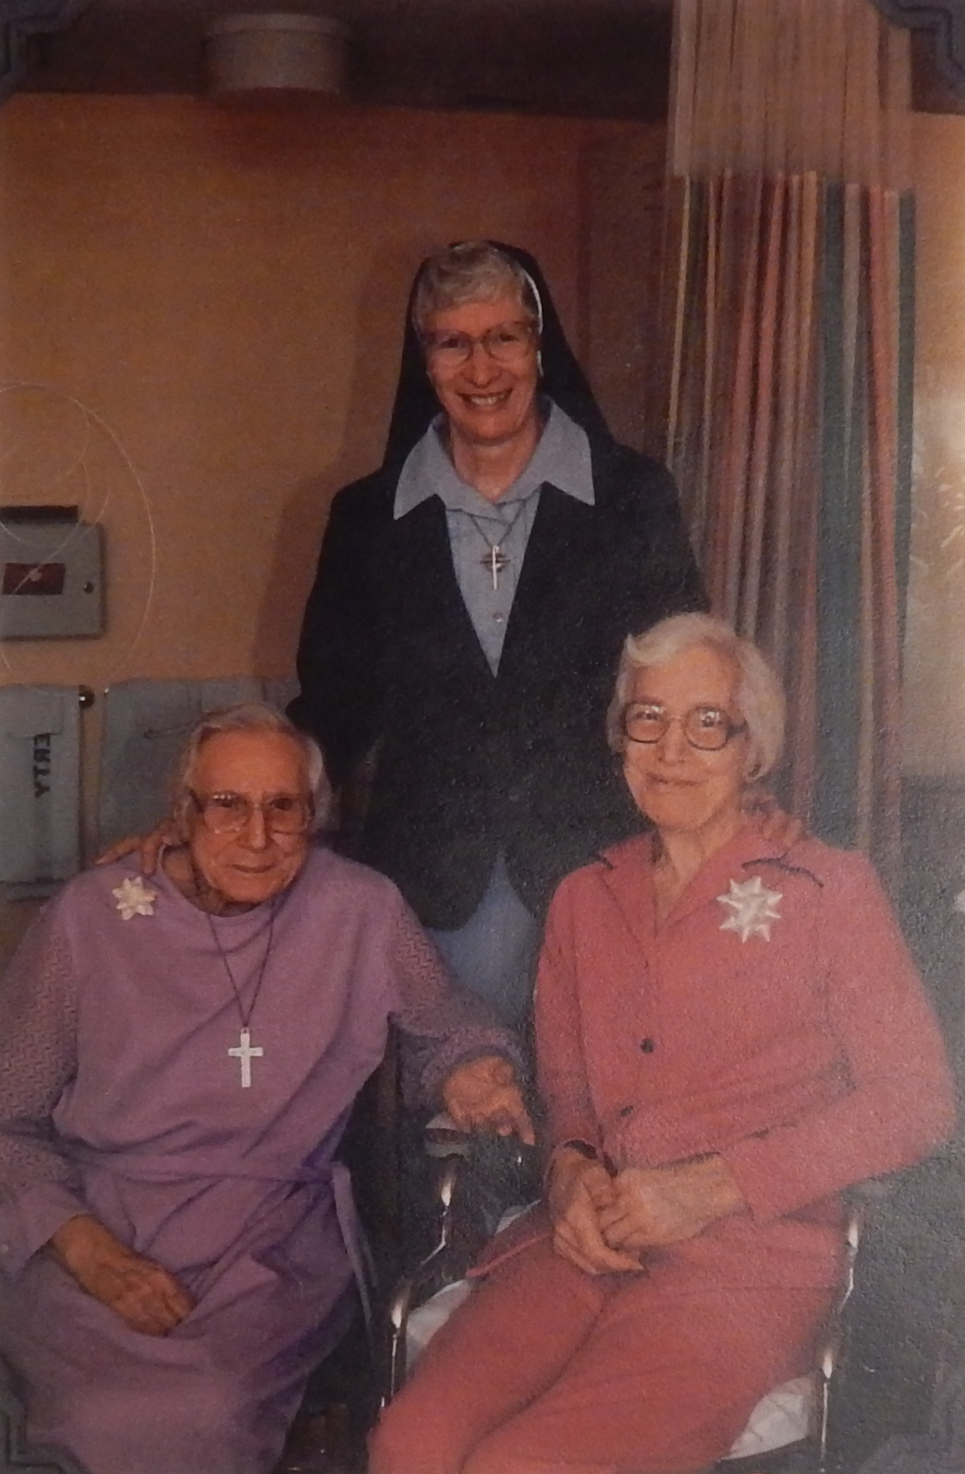
Irene Poquette and Hazel Cook, seated, with unidentified nun in background, circa 1990.
Notes:
Historians tend to discuss institutions for persons with intellectual disabilities as though they served a fairly homogenous, “high-grade” population that was only nominally feeble-minded
BUT, looking at the Brandon Training School, it is evident that there were vast disparities between the enrichments and treatment regimens directed at “high-grade” and “low-grade” inmates.
Historians privilege the history of “high grade feeble-mindedness” because it is easier to reconcile with their understanding of the social model of disability
Persons with more significant intellectual disabilities, who were marginalized within institutions, are thus doubly marginalized due to historians’ unwillingness to affirm the distinctiveness of their consciousness and experience
Recovering their consciousness and experience within the history of institutions for the intellectually disabled raises unsettling questions about the limits of present-day disability scholarship and activism

Slide 19
Making claims: Scientific/Cultural/Social: Questions
This week focuses especially on categorizing people. What are some of the key factors that shape these categories? How do these factors amplify, compare, complicate, undermine or otherwise relate to one another?
Who may/does benefit from the categories and applications of eugenic policies? Who might not/doesn’t? Why?
Different ideas about community underlie our sources this week. What factors shape these different interpretations and experiences of community?
What does the study of eugenics and of different disability communities teach us about love, sex, race, and disability?

